Slide 1
Amazing Achievements

Slide 2


Slide 3
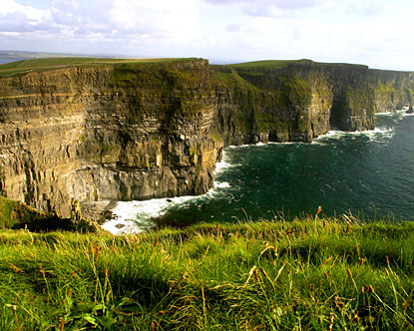

Slide 4
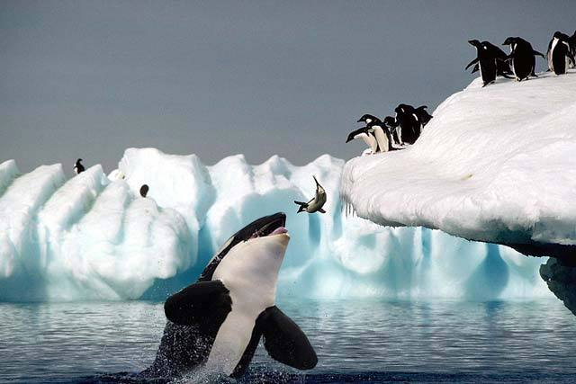

Slide 5
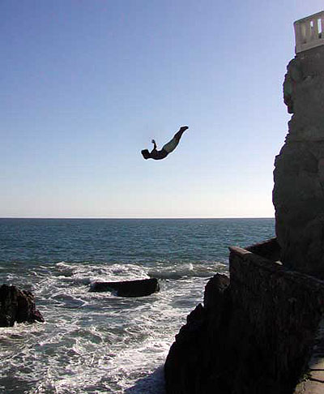


Slide 6
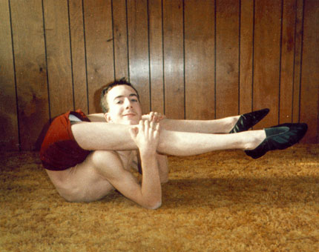
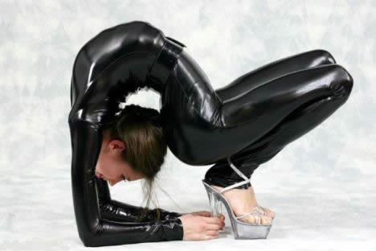
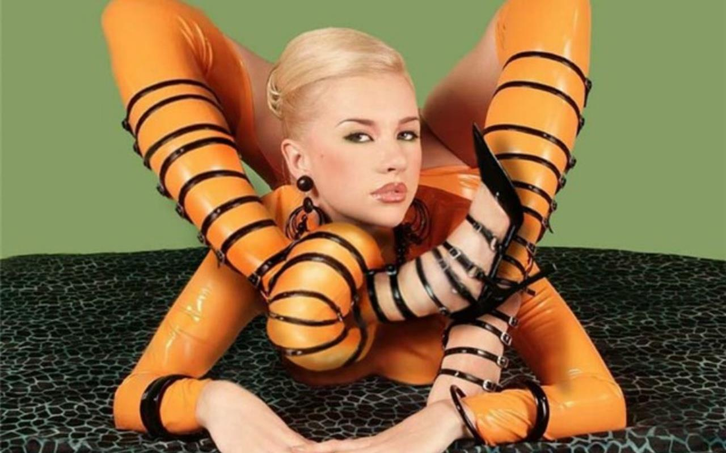
http://www.youtube.com/watch?v=6UAL8lhbsB4

Slide 7

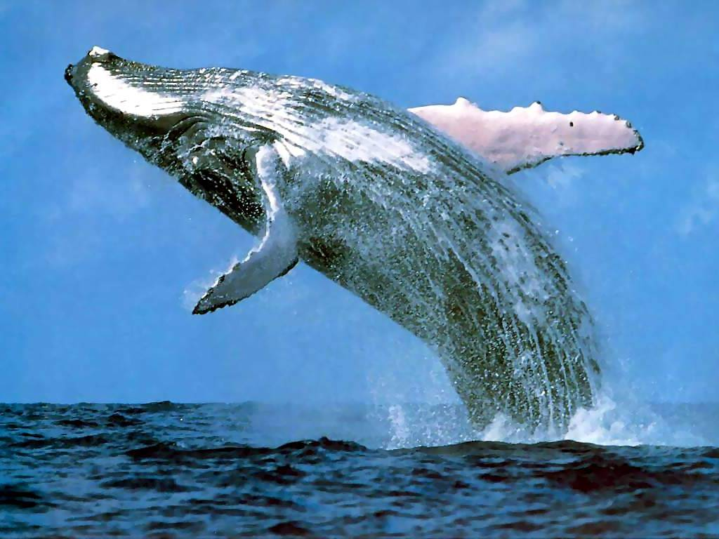

http://www.youtube.com/watch?v=6UAL8lhbsB4

Slide 8



Slide 9
Connecting ideas with “because” and “so”
Basic 08 Unit 11b

Slide 10
Why do you use because to connect sentences?
To give the reason or reasons for something

Slide 11


Callie Rogers won the lottery ! ☺
She is rich now because she bought the winning ticket.
She is rich, so she bought a big new house.
But also Callie is sad because she doesn’t have any friends ☹

Slide 12
Examples :
Example:
She took the bus to work because her husband took her car.
Because her husband took her car, she took the bus to work

Slide 13
Example:
She takes lots of pictures, so her photoalbums are full.
Because I have a lot of patience, I don’t get angry easily.
I don’t get angry easily because I have a lot of patience. ☺

